Slide 1
Used Car Listing Price Prediction
Presented by Team 13​

Slide 2
AGENDA
The Case​
Primary goals
​Data
The Plan

Slide 3
The Case
If the price is too high, it won’t attract any customers.
If the price is too low, the seller will incur a loss.
Hence, we need to predict a suggested listing price that is somewhere in the middle, however, the sellers can choose to list their cars on a price of their own.
In the UK, approximately 1.65 million new cars were sold in 2019, while the market was dominated by used car sales (7.53 million). The eventual sales prices are determined by demand – supply curves in the equilibrium. However, the listing price is of economic significance to a personal seller.
Primary Goal:
To predict listing price of used cars based on previous datasets available using relevant analysis models and tools.
For this, we need to:
Find a relevant dataset
Clean the data
To find out various features of a car that are relevant for a customer and analyze their effects on the list price

Slide 4
Our plan
Finding a relevant dataset
Cleaning the data
Exploratory data analysis (EDA)
Splitting the data
Models to train and test data

Slide 5
Data
Dataset on Kaggle
Rows: 361683
Features: 21
Categorical: 11
Numerical: 6
Text: 4
Type: Regression

Slide 6
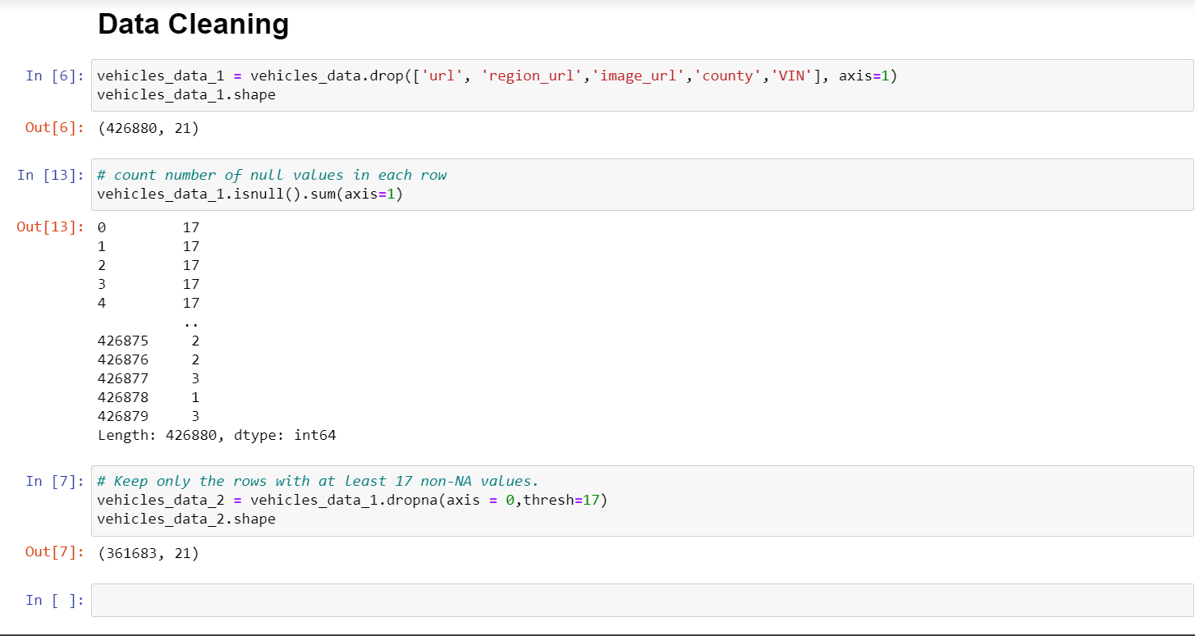

Slide 7
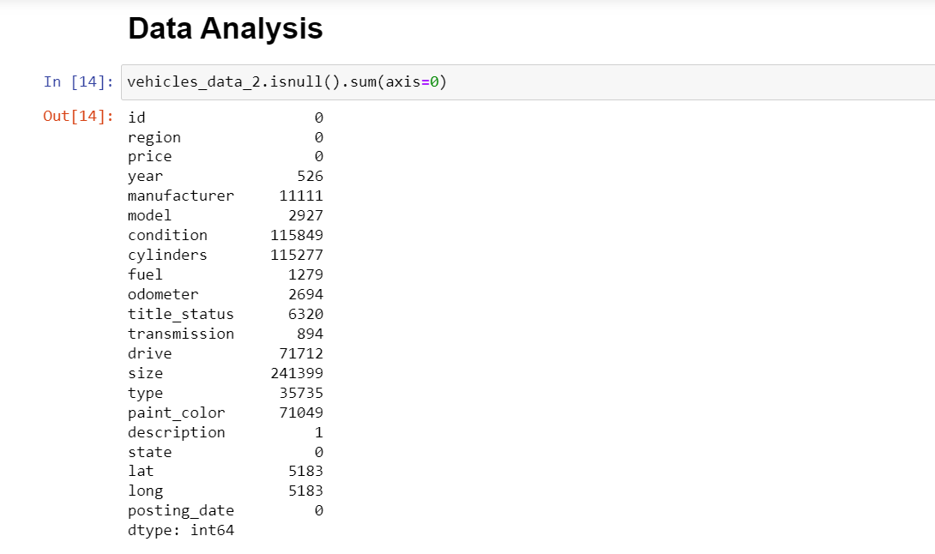

Slide 8
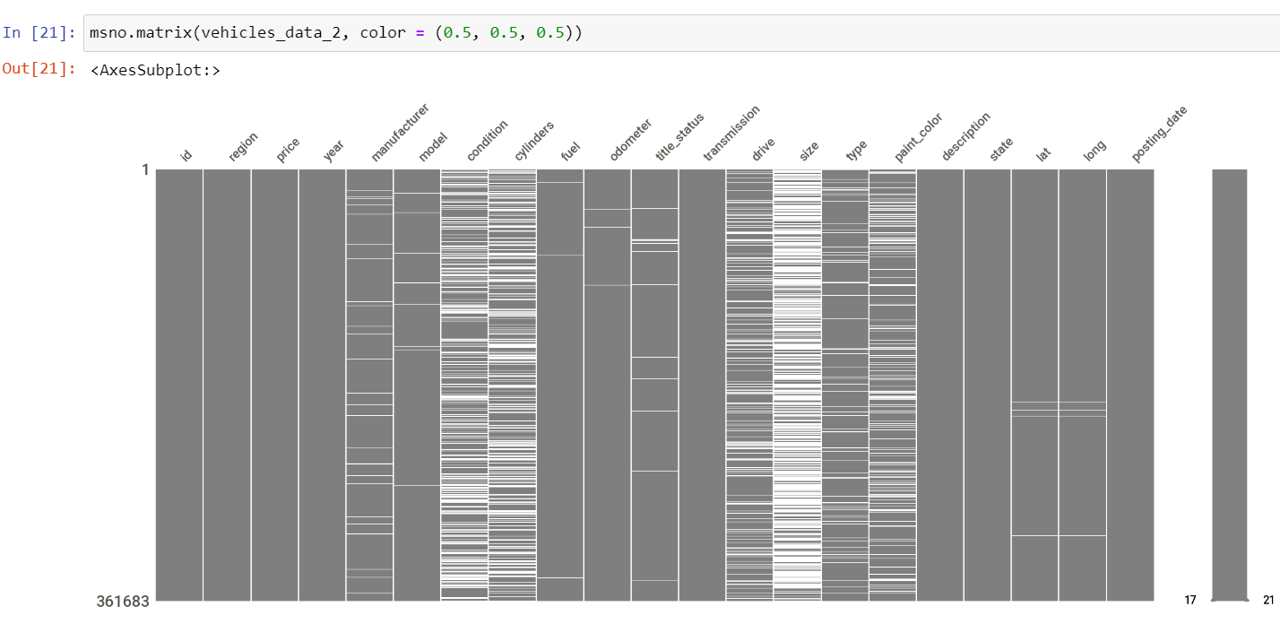

Slide 9
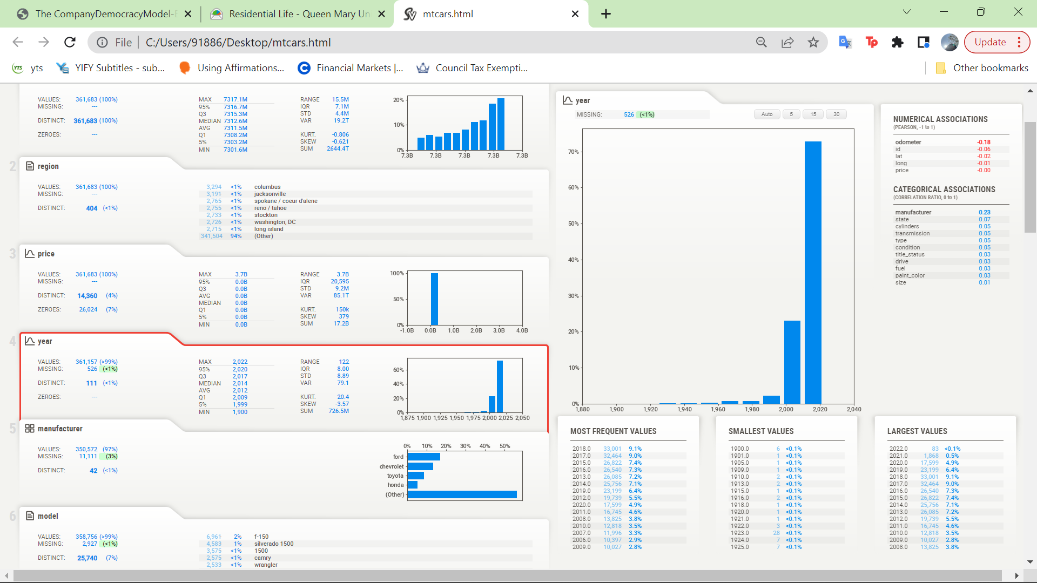
This graph represents the number of cars that have been listed over the years. Very evidently, the majority of the cars have been listed during the years 2000-2022. The data available to us in the dataset for all previous years is almost negligible. Hence, price prediction on the basis of the data of these years will not be very helpful.

Slide 10
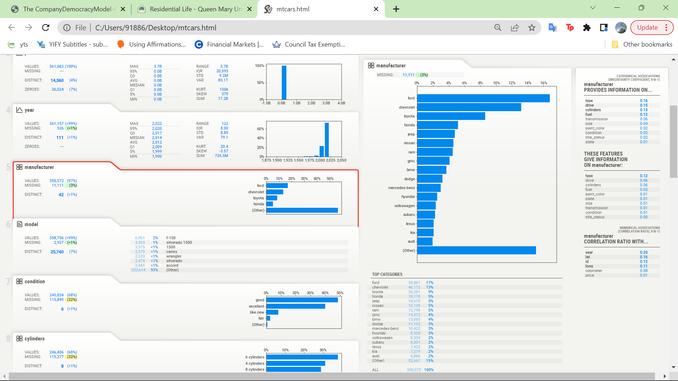
17%
13%
This graph represents the number of cars of different manufacturers listed for resale. From the data, we can see that the majority of cars are manufactured by Ford. The second most common manufacturer in our dataset is Chevrolet. Looking at this data we can make an assumption about the target audience.
9%
5%
15%

Slide 11
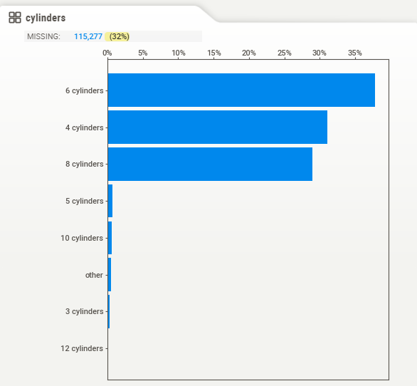
This graph shows the number of cylinders in different cars listed for resale. From this graph we can see that most cars have 6 cylinders and hardly any car has 12 cylinders. This a major feature the customer consider while buying a car.

Slide 12
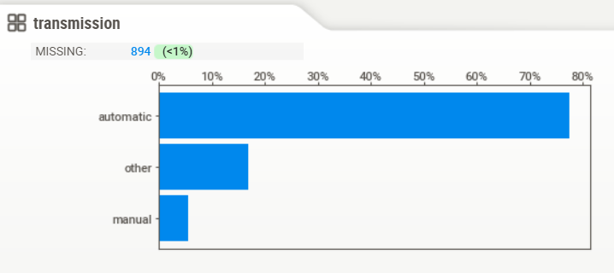
Another important feature of a car is the transmission. This graph shows the percentage of cars that have automatic, manual and other transmission. A major chunk of cars that are listed show automatic transmission.

Slide 13
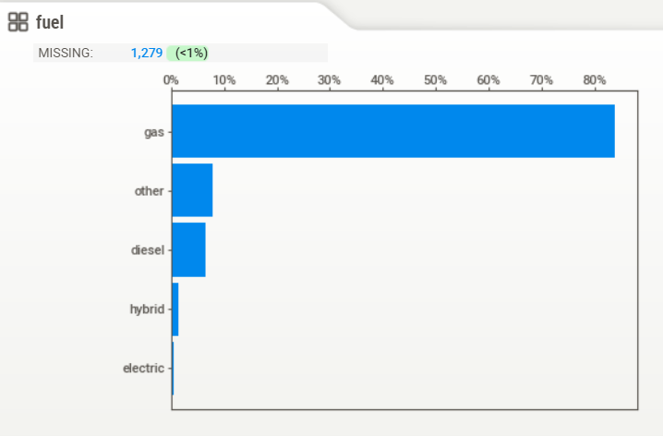
Fuel prices highly impact the car consumers and hence is an important aspect to look at while purchasing a car. This graph show the type of fuel each car uses. As it can be seen, 84% of the cars listed use gas and only 6% cars use diesel. There are hardly any electric cars that have been listed.
84%
8%
6%

Slide 14
THANK YOU
Rachit Gupta
Chirag Murali
Snehal Srivastava
Riya Mangal
Dhruv Sangwan

